Slide 1

LBS INSTITUTE OF TECHNOLOGY FOR WOMEN, POOJAPPURA
695012
DEPARTMENT OF COMPUTER SCIENCE & ENGINEERING
S6 Mini Project
Review - Presentation I
TOPIC : Voice - Controlled Slide Navigation for Powerpoint Presentations
Guided By,
Prof. Sandeep Chandran
Assistant Professor
CSE Department
Presented By,
Maria Tresa Binu (06)
Merin Chinnu Varghese (09)
Pinky S Thomas (31)

Slide 2

SLIDE-SYNC
VOICE - CONTROLLED SLIDE NAVIGATION
FOR
POWERPOINT PRESENTATIONS

Slide 3

CONTENTS
Introduction
Identification Of Problem
Motivation
Literature Review
Objectives
Design
Block Diagram
Project Plan
Conclusion
References

Slide 4

INTRODUCTION
PowerPoint presentations are highly effective for professional information exchange, facilitating clear communication and engagement through visuals, aiding in conveying complex ideas succinctly and engagingly.
This being a widely used tool, it is important ensure smooth navigation during the presentation.
Even though there are several hardware and software tool to cater to this need but unfortunately they aren't widely used.

Slide 5
MOTIVATION
Our major motivation was witnessing sessions where the speakers struggled to navigate through the slide according to their need while taking a session.
Slide remote instability increases speaker anxiety, leading to skipped slides. Smooth presentations are compromised, toggling slides manually.
Several factors determine a successful presentation. Some of them are uninterrupted flow of session,effective time management, audience interaction etc

Slide 6

IDENTIFICATION OF PROBLEM
To understand the problem better we conducted a survey among 50 people
The respondent included PhD Students,college students,Professors etc.
The survey was conducted to understand the following factors:
1.Mindset of the presenter while presenting
2.How popular are existing slide changing tools.
3.What functionalities do the users prefer when such a tool is developed.

Slide 7
Here are our findings…

Slide 8
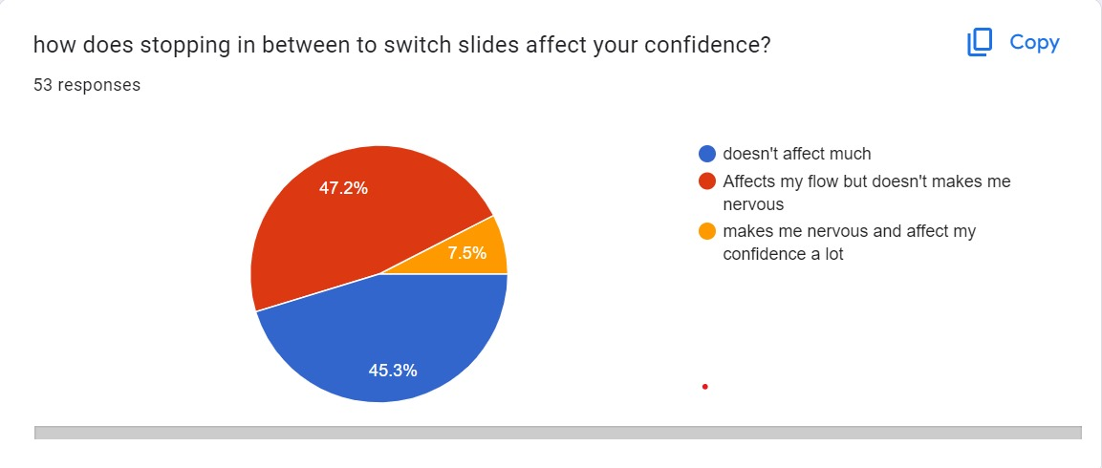
7.5% people have responded that it affects their confidence and makes them nervous.
60% of total individuals experience presentation disruptions due to manual slide changes or instructing someone to do so, hindering the flow.

Slide 9
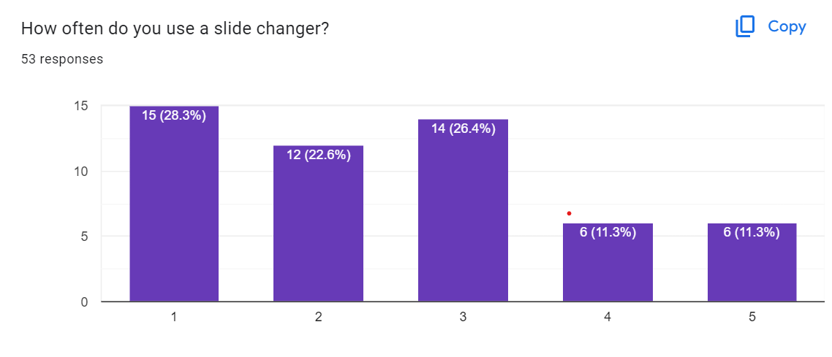
Never
Rarely
Sometimes
Often
Always
From this graph it is understood that the no.of people using slide changers are comparatively less.
It can be seen that the percentage of people never using slide changers are slightly higher than the others.

Slide 10
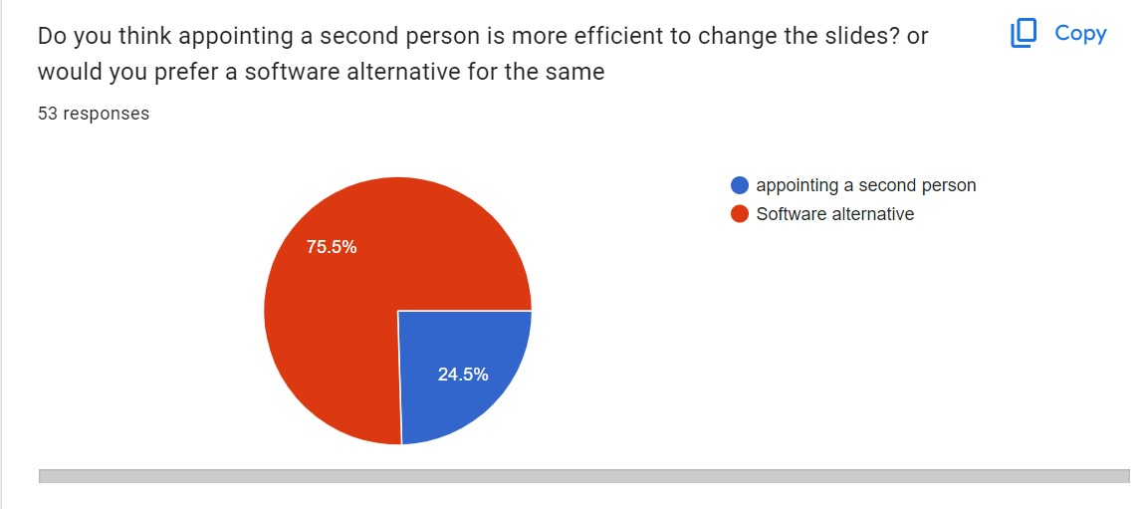
From the above chart it is clear that a software alternative is preferred by most of the users (75.5%).
This clearly shows the relevance and need of such a tool we are planning on building.

Slide 11
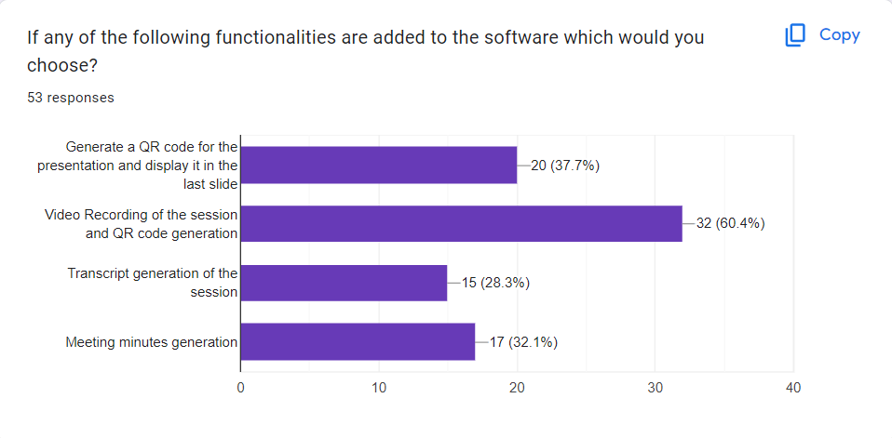
Requirements Preferences of Respondents

Slide 12
LITERATURE REVIEW

Slide 13
YEAR | TITLE OF THE PAPER | JOURNAL/ CONFERENCE | AUTHORS | OBSERVATION
2020 | A DESKTOP APPLICATION TO HELP SPEAKERS SWITCH SLIDES BY USING AI AND VOICE RECOGNITION | Journal | Yixin Liang, Marisabel Chang | Uses Assembly AI’s SpeechRecognition library for implementation.Specifically uses Hotword detection for enhanced speed. Uses the keyword “Next” and “Previous” to navigate through slides. Disadvantage: Using more than 5 customised hotwords compromises the speed of recognition and response. Using default keywords which aren’t unique will accidentally trigger a response
2020 | SimulSpeech: End-to-End Simultaneous Speech to Text Translation | Journal | Yi Ren,Jinglin Liu , Chen Zhang,Tao Qin,Zhou Zhao,Tie-Yan Liu | Implements simultaneous speech to text translation using wait-k strategy. This helps to extract the commands from voice and decode it simultaneously without causing a delay.

Slide 14
YEAR | TITLE OF THE PAPER | JOURNAL/ CONFERENCE | AUTHORS | OBSERVATION
2022 | TASE: Task-Aware Speech Enhancement for Wake-Up Word Detection in Voice Assistants | Journal | Guillermo Cámbara Fernando López, David Bonet, Pablo Gómez, Carlos Segura, Mireia Farrús, Jordi Luque | Uses automatic speech recognition modules along with wake up word(WAW) module to increase the robustness of WAW. By using an ASR module the wake up word can be extracted from background noises and triggers a particular functionality.
2023 | QR CODE GENERATOR USING PYTHON | Journal | Gadi Sudheshna, V. Sarala | QR code encoding,Types of QR Codes. QR code generation using python libraries.

Slide 15
EXISTING SYSTEM
A slide changing remote is a compact wireless device for controlling slide progression during presentations.
Drawbacks:
Technical malfunction
Distraction to presenters
Compatibility issues
Cost
Slide changers controlled using hand gestures are the recent innovations.
Google's new cell phone presentation remote control, while resembling traditional slide remotes, is limited to Google Slides, making it less practical for formal settings or environments with restricted cell phone usage.

Slide 16

OBJECTIVES OF PROPOSED SYSTEM
To develop handsfree slide control using speech recognition and wake word methods
To develop QR code of material used for presentation, allowing the audience to access the presentation at the end.

Slide 17
DESIGN
Feature Extraction
Give command (Wake word)
Speech Recognition Module
Word Recognition
Slide Changes
User
Front end Interface
Upload PPT File
Store the file in server
Retrieve Slide
QR code generation Module
QR code generation

Slide 18
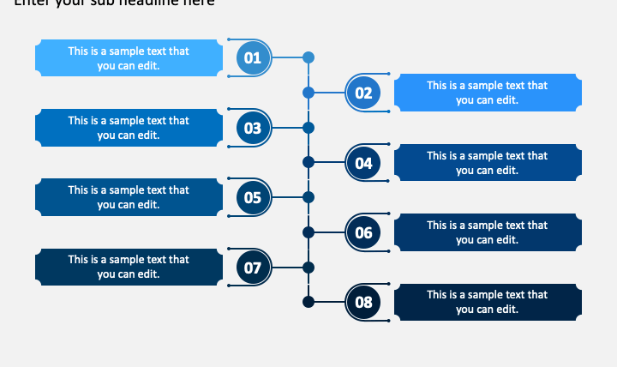
PROJECT PLAN
Jan 30 to Feb 07
Problem Identification
Feb 08 to Feb 25
Problem Study / Requirement analysis
Feb 26
Review 1
Feb 26 to Mar 15
Learning the required languages/ Basic functionality building
Mar 16 to Apr 10
Front End designing
Mar 25
Review 2
Apr 11 to Apr 21
Software Testing
Apr 22
Review 3

Slide 19
CONCLUSION
While PowerPoint presentations are powerful communication tools, the issue of smooth navigation persists, impacting presenter confidence and session flow.
Our research underscores the urgent need for innovative solutions to streamline slide navigation and alleviate disruptions.
By harnessing speech recognition, QR code sharing, and other features, we aim to revolutionize the presentation experience.
We are dedicated to overcoming challenges and delivering a solution that empowers presenters.

Slide 20
REFERENCES
[1] Yixin Liang¹ , Marisabel Chang²,” DESKTOP APPLICATION TO HELP SPEAKERS SWITCH SLIDES BY USING AI AND VOICE RECOGNITION”, 10th International Conference on Computer Networks & Communications (CCNET 2023)
[2] Yi Ren, Jinglin Liu, Chen Zhang, Tao Qin, Zhou Zhao, Tie-Yan Liu, “SimulSpeech: End-to-End Simultaneous Speech to Text Translation”, Proceedings of the 58th Annual Meeting of the Association for Computational Linguistics,2020
[3]Mishaim Malik, Muhammad Kamran Malik,Khawar Mehmood, Imran Makhdoom, “Automatic speech recognition: a survey
”, Multimedia Tools and Applications 80(3):1-47,March 2021
[4] GADI SUDHESHNA¹ , V. SARALA², “QR CODE GENERATOR USING PYTHON ”, International Journal of Engineering Science and Advanced Technology (IJESAT) Vol23 Issue 9,2023

Slide 21
THANK YOU

